Slide 1
Word Embeddings
Max Lei and Grehg Hilston

Slide 2

Sponsored By

Slide 3
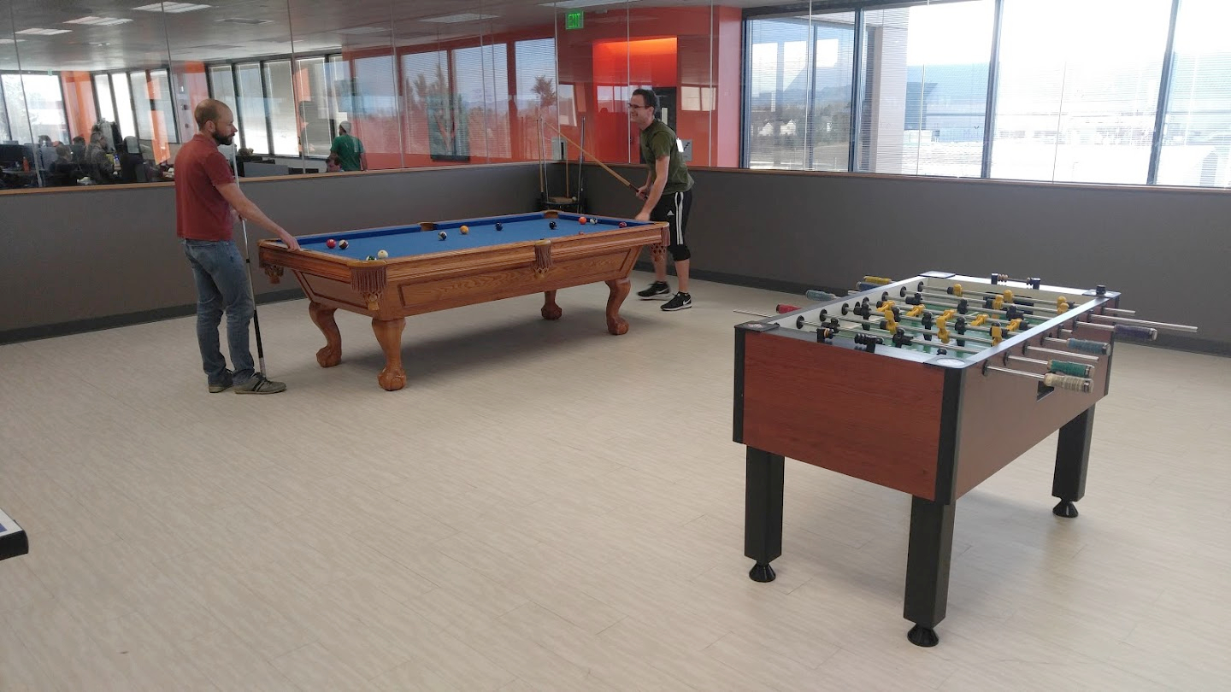

Slide 4
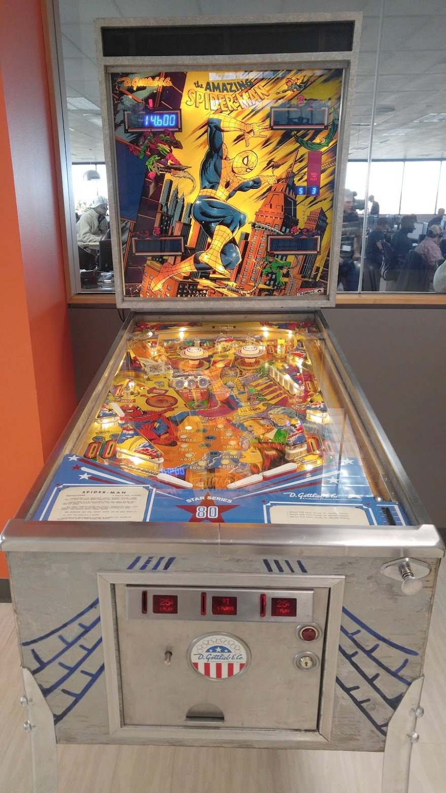
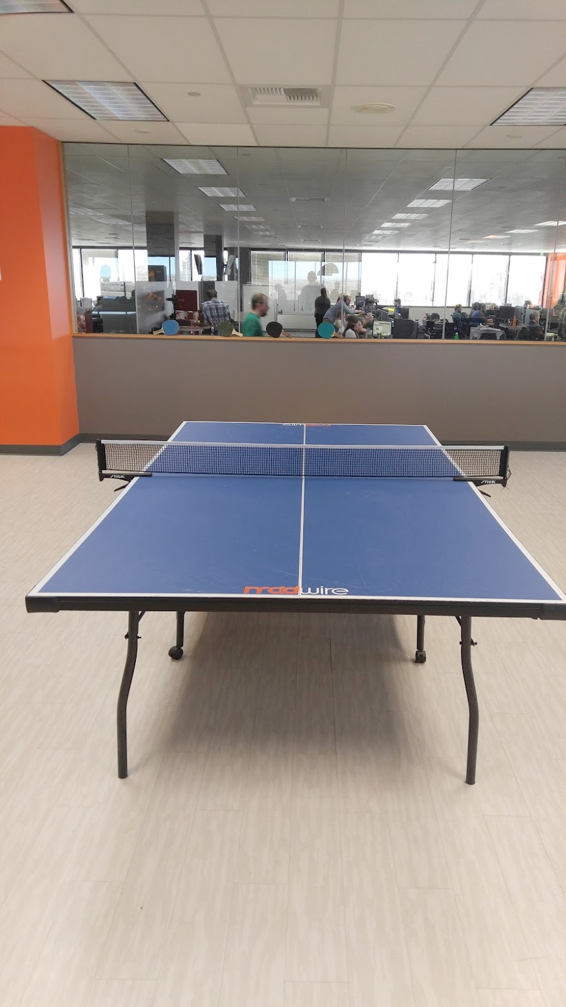


Slide 5

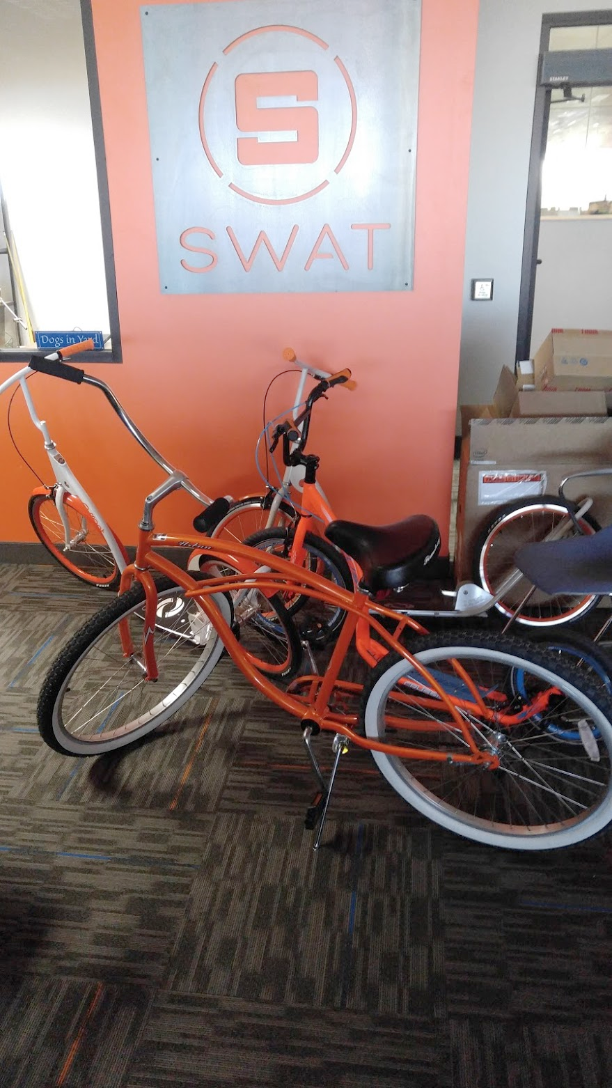
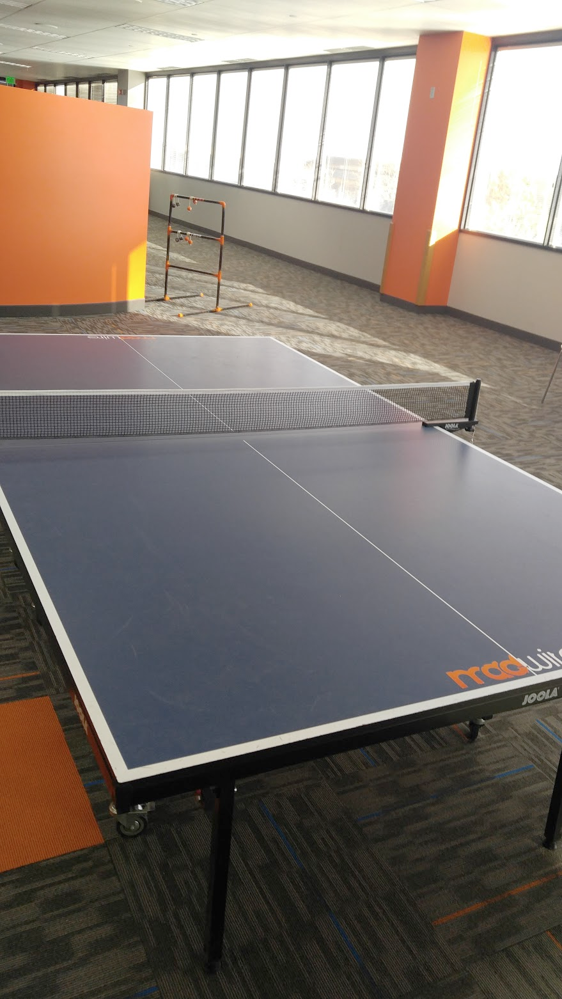

Slide 6
Overview (Madwire)
Theory Presentation (30 minutes)
Why / how this stuff works
Implementation Presentation (30 minutes)
How to use this stuff in a project

Slide 7
Overview (DS Meetup)
Theory Presentation (20 minutes)
Why / how this stuff works
Implementation Presentation (20 minutes)
How to use this stuff in a project
Personal Exploration (20 minutes)
Practice using this stuff in code

Slide 8
Vocab
Document:
A single collection of words
Examples:
Books
Blog posts
CNN article
Corpus:
A collection of documents

Slide 9
Now For Some Jokes
I like my coffee like I like my wars, cold
I like my boys like I like my sectors, bad
I like my relationships like I like my source, open

Slide 10
Word Embeddings
Definition = “words from the vocabulary are mapped to vectors of real numbers”
By converting words to a vector representation, we can apply many mathematical operations
There exists premade word embeddings online, created from millions of sources

Slide 11
Usages
Programmatically generating contextually similar words
Creating simple filters
Judging how similar two documents are
Sentiment analysis
Document Classification

Slide 12
Potential Problems
Word ambiguity
Pool: billiards games
Pool: swimming pool
Vectors only as good as the data you use

Slide 13
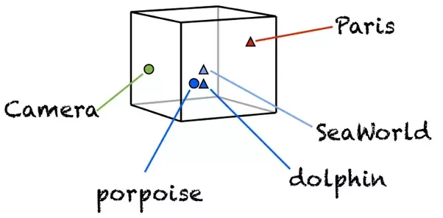
Why Are Word Embeddings Cool?
Words with similar meanings can be clustered

Slide 14
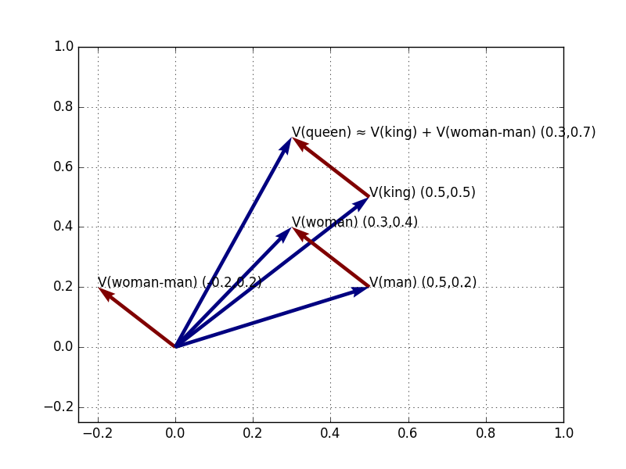
Why Are Word Embeddings Cool? Part 2
You can perform addition or subtraction on word embeddings
Example:
king - man = ?
Vectors will produce queen

Slide 15
Dimension Reduction
One can reduce dimensions of a data set
You’ll lose some data
But keep the jist of what is going on
This actual process is rather complicated

Slide 16
What Is A Word Embeddings?
ELI5: Turning text into numbers
This process is necessary as many machine learning algorithms operate on vectors of continuous values and won’t work on strings
Bag of Words
Used for huge, very space vectors
Word Embeddings
Used for semantic parsing
Extracts meaning from text, enabling natural language understanding

Slide 17
Why Does This Work?
Context clues are incredibly powerful for determining what a word is:
“A small, fluffy roosety climbed a tree.”
Q: What’s a “roosety”?
“a word is characterized by the company it keeps” - John Rupert Firth
Like mentioned before, a bag of words might not be able to discern this
However, word embeddings may be able to

Slide 18
Other Simple NLP Procedures
Bag of Words
One vector per document
TF-IDF
Simple Co-Occurrence
One vector

Slide 19
Bag of Words
We will create a dictionary for each document
Keys = any word that occurs at least once in any document
Values = count of this word in this given document
Example:
Corpus
Document 1: “The quick brown fox jumped over the lazy dog”
Document 2: “The lazy dog jumped over the friendly cat”
 | the | quick | brown | fox | jumped | over | lazy | dog | friendly | cat
d1 | 2 | 1 | 1 | 1 | 1 | 1 | 1 | 1 | 0 | 0
d2 | 2 | 0 | 0 | 0 | 1 | 1 | 1 | 1 | 1 | 1
Notes:
The most common type of characteristics, or features calculated from the Bag-of-words model is term frequency, namely, the number of times a term appears in the text.
Does not preserve ordering
Has been used for email filtering

Slide 20
Bag of Words Continued
Problems:
Syntactic and semantic accuracy isn’t as high as it should because of the fact that context is king.
For instance; ‘Chicago’ means one thing and ‘Bulls’ means another, but ‘Chicago Bulls’ means a completely different thing.
Counting word-frequencies doesn’t take this into account.

Slide 21
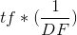
TF-IDF Vector
TF-IDF
Term Frequency - Inverse Document Frequency
Ensure that you understand this is hyphen and not a minus sign
Term Frequency
the number of times a term occurs in a document
Inverse Document Frequency
The inverse function of the number of documents in which the term occurs
Used to
diminish the weight of terms that occur very frequently
Increase the weight of the terms that occur rarely

Slide 22
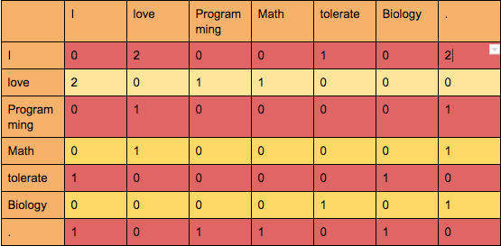
Simple Co-occurrence Vectors
Take into account neighboring words
Example: “I love Programming. I love Math. I tolerate Biology.”

Slide 23
Simple Co-occurrence Vectors Continued
Once we have the co-occurrence matrix filled we can plot its results into a multi-dimensional space.
Since ‘Programming’ and ‘Math’ share the same co-occurrence values, they would be placed in the same place; meaning that in this context they mean the same thing (or ‘pretty much’ the same thing).
The semantic and syntactic relationships generated by this technique are really powerful but it’s computationally expensive since we are talking about a very high-dimensional space.
Therefore, we need a technique that reduces dimensionality for us with the least data-loss possible.
Answer: Glove Vectors

Slide 24
How Are Word Vectors Made?
Vectors are made by walking through data sets of text
Vocab
Document = a single thing of related text
Examples:
A book
A CNN article
A Wikipedia page
Corpus = a set of documents
Examples:
An online library
A reddit user’s post history
Each document in the corpus is traversed, building up the vectors by document
Notes:
Simplify: A bunch of text is gathered to be processed

Slide 25
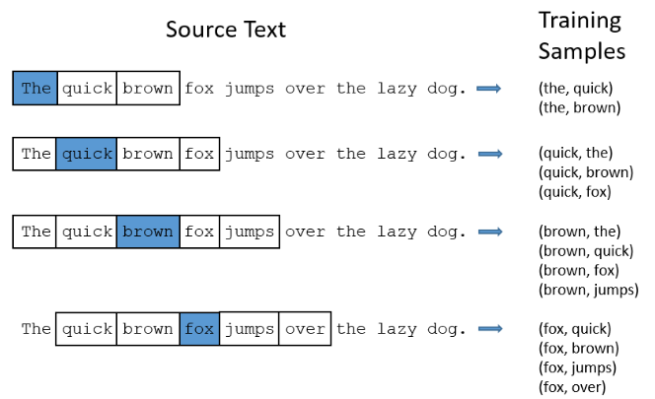
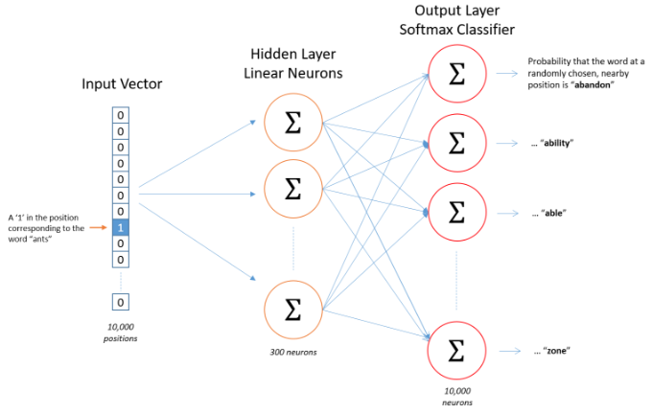
Creating Word Embeddings
Notes:
Given text, tokenize
Given tokens, one hot encode
Given one hot encode, minimize loss needed to select neighboring words
The embedding values are the weights going from the one hot encoding, to the first hidden layer

Slide 26
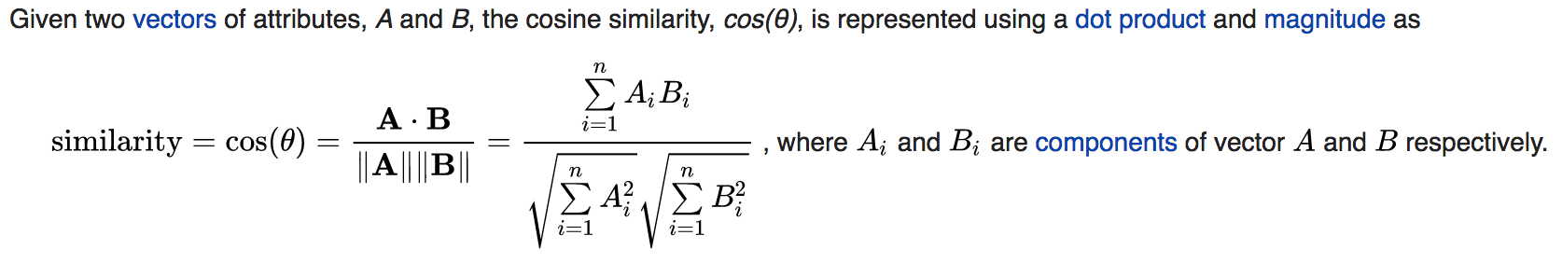
Cosine Similarity
Dictates how related two word embeddings are
Notes:
the result of a dot product between two vectors isn’t another vector but a single value, a scalar.

Slide 27
Cosine Similarity Example
We have the following documents
D1 = “Julie loves me more than Lina loves me”
D2 = “Jane likes me more than Julie loves me”
We want to know how similar these texts are, purely in terms of word counts (and ignoring word order). We begin by making a list of the words from both texts:
[me Julie loves Linda than more likes Jane]

Slide 28
Cosine Similarity Example Continued
3. Now we count the number of times each of these words appears in each text:
me 2 2 Jane 0 1 Julie 1 1 Linda 1 0 likes 0 1 loves 2 1 more 1 1 than 1 1

Slide 29
Cosine Similarity Example Continued
4. We are not interested in the words themselves though. We are interested only in those two vertical vectors of counts. For instance, there are two instances of 'me' in each text. We are going to decide how close these two texts are to each other by calculating one function of those two vectors, namely the cosine of the angle between them.
The two vectors are, again:
d1: [2, 0, 1, 1, 0, 2, 1, 1] d2: [2, 1, 1, 0, 1, 1, 1, 1]

Slide 30
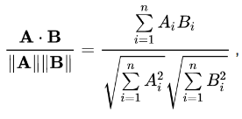
Cosine Similarity Example Continued
A . B = (2 * 2) + (0 * 1) + (1 * 1) + (1 * 0) + (0 * 1) + (2 * 1) + (1 * 1) + (1 * 1) = 9
A . A = sqrt((2 * 2) + (0 * 0) + (1 * 1) + (1 * 1) + (0 * 0) + (2 * 2) + (1 * 1) + (1 * 1)) = sqrt(12) = 3.46
B . B = sqrt((2 * 2) + (1 * 1) + (1 * 1) + (0 * 0) + (1 * 1) + (1 * 1) + (1 * 1) + (1 * 1)) = sqrt(10) = 3.16
9 / (3.46 * 3.16) = 0.822
These vectors are 8-dimensional. A virtue of using cosine similarity is clearly that it converts a question that is beyond human ability to visualise to one that can be.
In this case you can think of this as the angle of about 35 degrees which is some 'distance' from zero or perfect agreement.

Slide 31
Stop Words
Stop words: words which are filtered out before or after processing of natural language text
Usually refers to the most common words in a language
No official list exists
Examples:
The
Is
At
Which
On
Potential Problems:
Searching for words or phrases which use stop words
“The Who”
“Take That”

Slide 32
Top Rated Local’s Usage For Word Embeddings
Originally Top Rated Local had only sixty categories
A user was required to type in an exact match to make a valid search
So if a category called “Brewery” existed, typing in “Beer” would be invalid
Max and I iterated over every category and produced a list of similar words to improve searchability

Slide 33
Inappropriate Word Generation
During the process of generating similar words, we found categories were generating inappropriate words
This is due to our project using pre gathered word vectors, which could have been made from any sources on the internet
The inappropriate words all were sexual
At first we were puzzled how we were going to sensor the words
Q: How would you filter inappropriate words?
In the end, we simply subtracted “sex” from each vector and got a list of clean similar words

Slide 34
Useful Tools
Spacy
easy mode
Vectors, cosine similarity, entities and vocabulary
Gensim
Harder, yet more powerful
Vectors, cosine similarity and more
NLTK
Linguistics giving subjective value
https://projector.tensorflow.org/
Supah cooool

Slide 35
References
Image: https://qph.fs.quoracdn.net/main-qimg-3e812fd164a08f5e4f195000fecf988f
http://p.migdal.pl/2017/01/06/king-man-woman-queen-why.html
https://medium.com/ai-society/jkljlj-7d6e699895c4
https://www.quora.com/What-is-word-embedding-in-deep-learning
https://en.wikipedia.org/wiki/Stop_words
https://www.quora.com/Is-cosine-similarity-effective
https://stackoverflow.com/a/1750187/1983957

